Slide 1
Credit Card Risk Detection
AISC1006 – Group B
Anjitha Mohan
Devendra Singh Shekhawat
Gurbachan Singh
Jissy Jayaprakash
Jisna D Kunju
Leandro Sartini de Campos
Sherin Stanley
Sushma Rangisetti
Vishnu vardhan Dama
‎

Slide 2
Agenda
Introduction
Project Scope and Timeline
GitHub + Cookiecutter
DataPrep
Possible problems with our Data
How we will address these problems
Data Exploration
Findings about our data in general
Deep Dive on the Target variable
Next Steps
‎

Slide 3
Introduction
Credit Card Risk Detection
What is Credit Card Fraud?
How this problem is usually addressed in big banks.
Where does our data come from?
‎

Slide 4
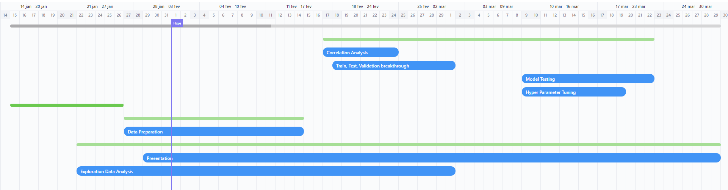
Project Scope + Timeline
Let’s deep dive on the future
‎

Slide 5
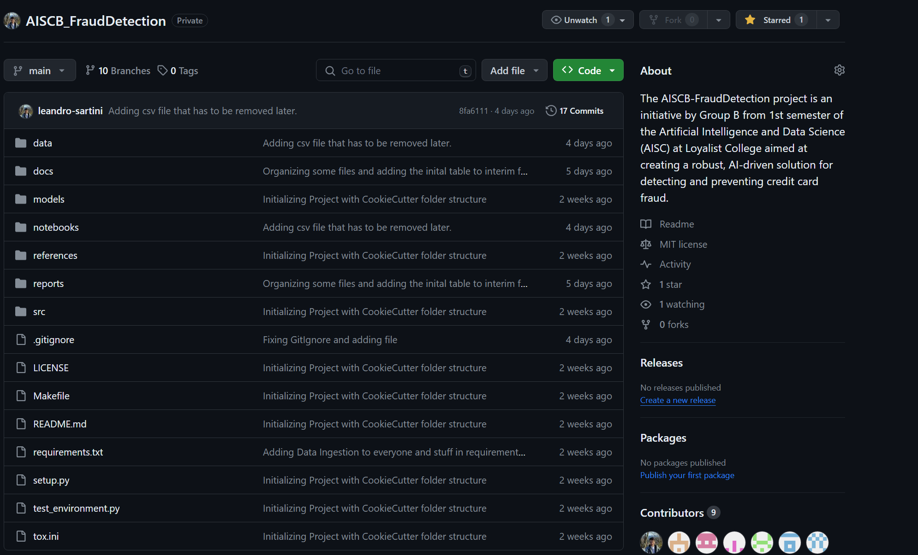
GitHub + Cookiecutter
What are these things?
What is GitHub, and how we structured of project there.
What is Cookiecutter, how it can help us?
‎

Slide 6
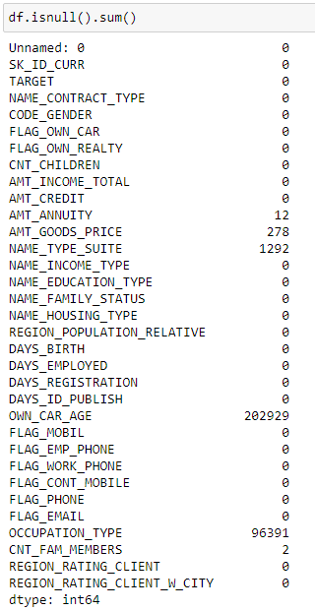
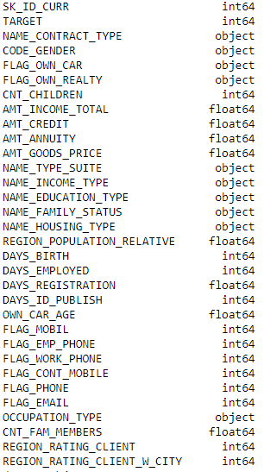
Data Prep
Null Values
We’ve got null values on some numeric variables such as Annuity and Goods Price;
We have a lot of nulls in Occupation Type;
For numeric values we may try to fix over using the grouped mean value, and maybe with better exploration we may find some that are 0’s
For Categorical such as Occupation Type we cannot directly infer, but actually understand, or just leave it as a “Not Describe”
‎

Slide 7
Overview of our Target
Fraud Category by Type of Loan
Family Status | Not Fraud | Fraud
Family Status | 0 | 1
Married | 181582 | 14850
Single / not married | 40987 | 4457
Civil marriage | 26814 | 2961
Separated | 18150 | 1620
Widow | 15151 | 937
‎

Slide 8
Deep Dive on our Target
Breakdown of Frauds by Occupation | Not Fraud | Fraud
Occupation Type | 0 | 1
Laborers | 49348 | 5838
Sales staff | 29010 | 3092
Core staff | 25832 | 1738
Managers | 20043 | 1328
Drivers | 16496 | 2107
High skill tech staff | 10679 | 701
Accountants | 9339 | 474
Medicine staff | 7965 | 572
Security staff | 5999 | 722
Cooking staff | 5325 | 621
Cleaning staff | 4206 | 447
Private service staff | 2477 | 175
Low-skill Laborers | 1734 | 359
Waiters/barmen staff | 1196 | 152
Secretaries | 1213 | 92
Realty agents | 692 | 59
HR staff | 527 | 36
IT staff | 492 | 34
‎

Slide 9
Next Steps
What lies ahead
Actually start cleaning the dataset;
Keep on deep-diving on the data-set;
Learn more about imbalance;
Learn how to work on branches on GitHub
‎

Slide 10
Thank You
Questions?
‎

